Slide 1
Building Enterprise Java Applications with Spring
Day 6
Magdalene Lim,
Desmond Lee,
Kavitha Muniraj
Republic Polytechnic

Slide 2
Welcome and admin matters
Please ensure that:
Attendance has been captured (via QR code scanning)
A learning laptop is with you
Good view on the display
Course materials are also available at: https://github.com/kavithamuniraj/CETSpringBootAY2022
Notes:
https://en.wikipedia.org/wiki/QR_code_payment

Slide 3
Admin matters
A tidy/clean laptop is a good laptop for learning
Files created on the laptop will linger on. To prevent this:
Create a folder in the "Documents" location for this workshop
E.g. “SpringBoot-Alan" or “SpringBoot-PeterPan“
All user created files to be placed in this folder
Delete that folder after the course
Notes:
https://en.wikipedia.org/wiki/QR_code_payment

Slide 4



Trainers
Magdalene Lim
Senior Lecturer
School of Infocomm
Magdalene_lim@rp.edu.sg
Desmond Lee
Associate Lecturer
School of Infocomm
DESMOND_LEE@myrp.edu.sg
Kavitha Muniraj
Lecturer
School of Infocomm
Kavitha_muniraj2@rp.edu.sg
Notes:
https://en.wikipedia.org/wiki/QR_code_payment

Slide 5
Schedule
Time | Agenda
9:00 am - 9:15 am | Welcome and admin matters
9:15 am – 10:30 am | Spring Security, Authentication with Default User
10:30 am – 10:45 am | Break
10:45 am – 12:30 pm | Authentication with Custom User
12:30 pm – 1:30 pm | Lunch
1:30 pm – 3:15 pm | Authorization, Adding new member
3:15 pm – 3:30 pm | Break
3:30 pm – 4:45 pm | Custom login/logout
4:45 pm – 5:00 pm | Wrap up, Q&A
Notes:
https://en.wikipedia.org/wiki/QR_code_payment

Slide 6
Topics Covered in this course
Spring Security
Authentication with Spring Default User
Authentication with Custom users
Authorisation
Handling Restricted Access
Adding New Members
Custom Login/LogoutValidation
Notes:
https://en.wikipedia.org/wiki/QR_code_payment

Slide 7

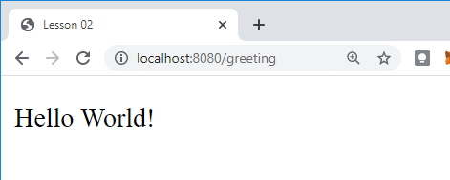
RECALL - REST API – Client Server Model
1. The client makes a request
http://localhost:8080/greeting
2. The web server receives the request and passes it to the controller.
3. GreetingController.java processes request and returns response (View)
greeting.html
(View)
4. The client displays the response received.
Notes:
What web server are we using?

Slide 8
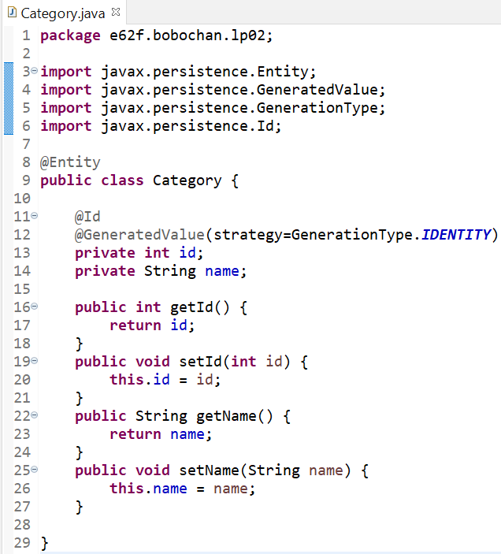
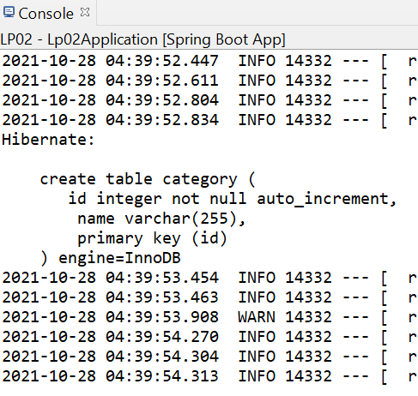
RECALL - JPA-Hibernate-MySQL
Springboot application
Spring Data JPA
Hibernate ORM Framework
MySQL DB

Slide 9
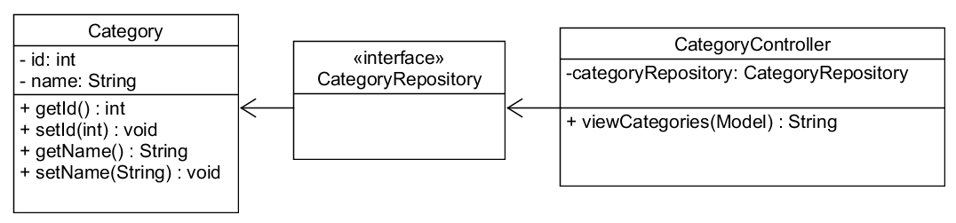
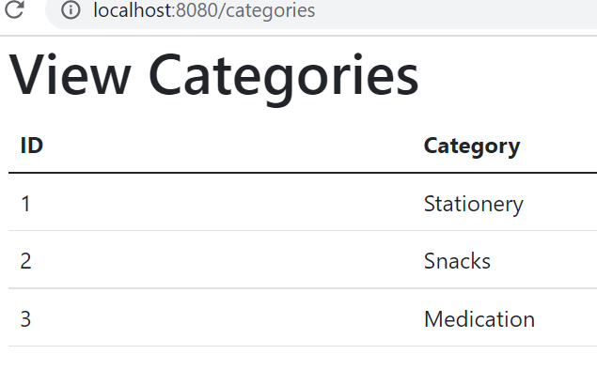
RECALL - Viewing a list of categories

Slide 10
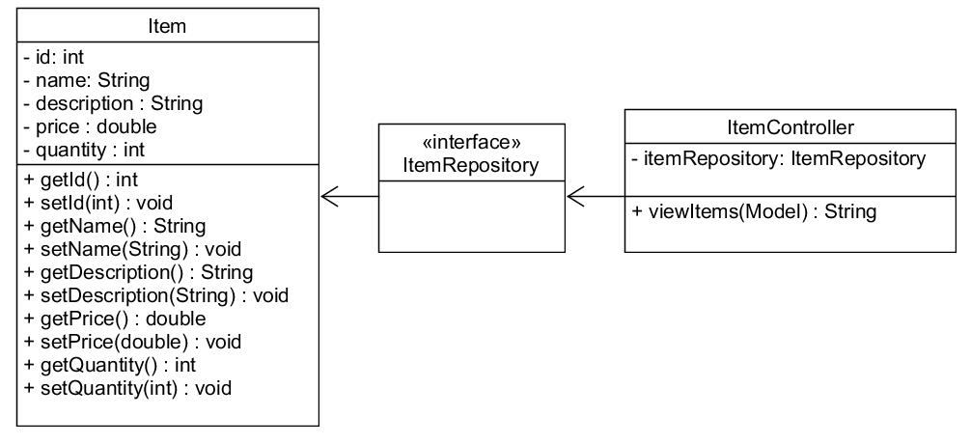
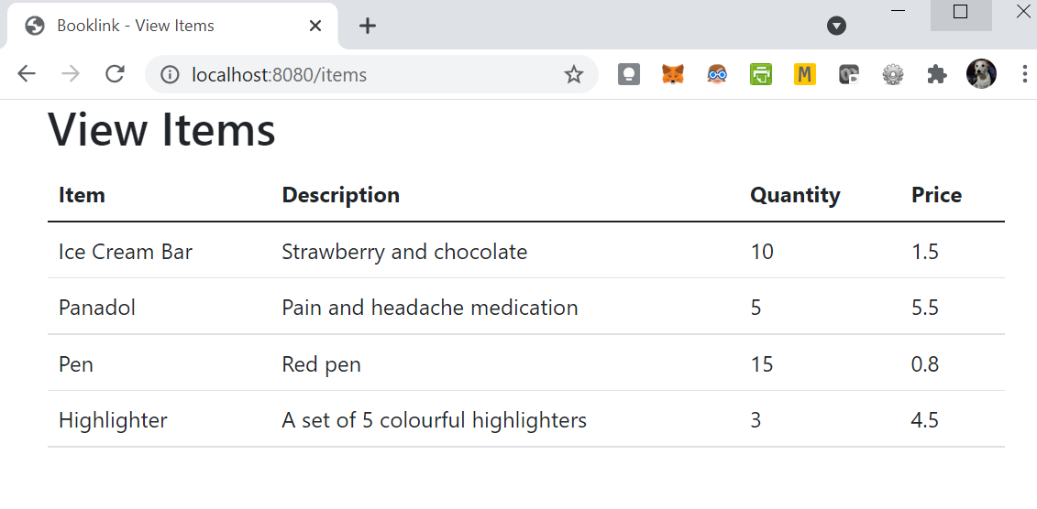
RECALL - Viewing a list of items

Slide 11
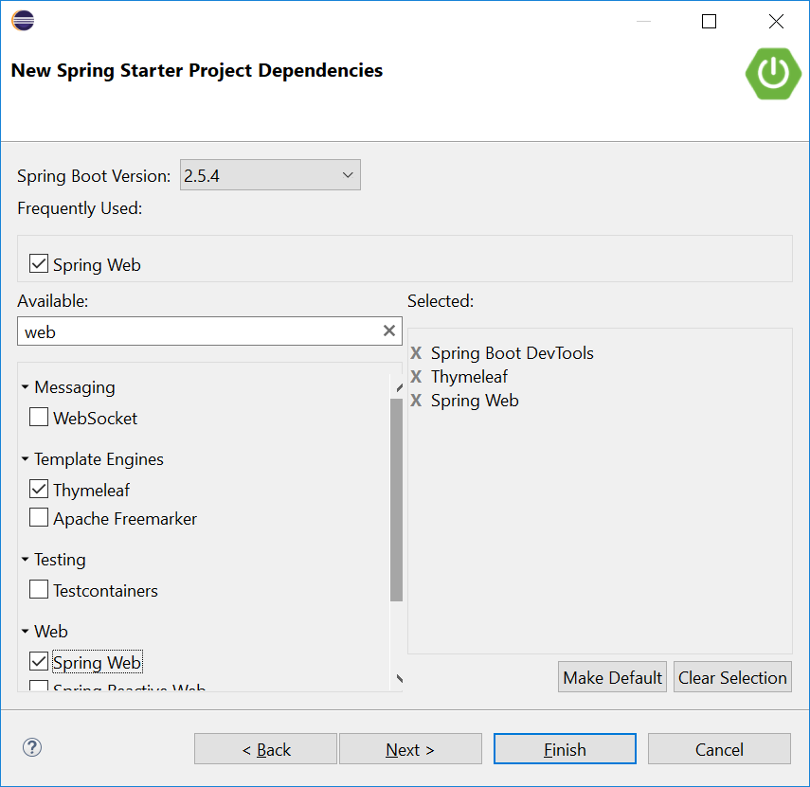
RECALL - Thymeleaf
Recall that in our Springboot projects, we included a dependency, Thymeleaf.
Thymeleaf is a server-side Java template engine for both web and standalone environments.
It is a view technology that performs server-side rendering of HTML.
We use variable expressions ${…} bind the data from the template context(model) into the resulting html(view).

Slide 12
RECALL: Thymeleaf attributes
th:each - used for iteration
th:text - evaluates its variable expression and sets the result of this as the body of the tag it is in
As we progress in the lessons, we will be using more types of attributes. You can find the full list here:
https://www.thymeleaf.org/doc/tutorials/3.0/usingthymeleaf.html#setting-attribute-values

Slide 13
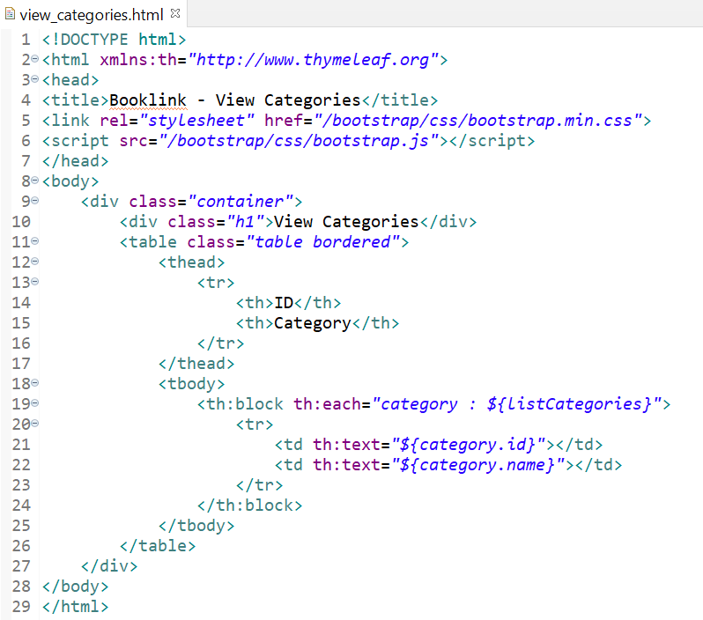
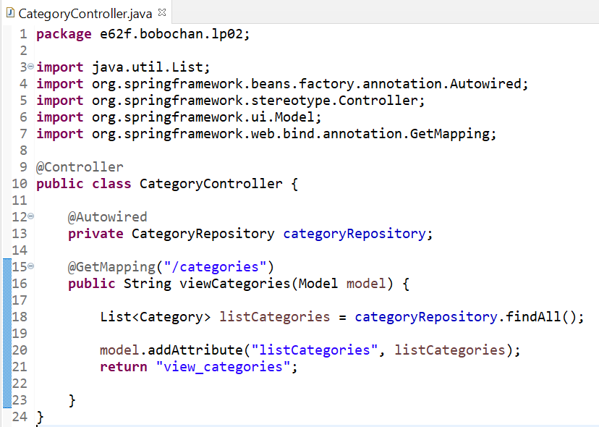
RECALL –View Categories
We used the variable expression ${…} to retrieve the information stored in the model attributes.

Slide 14
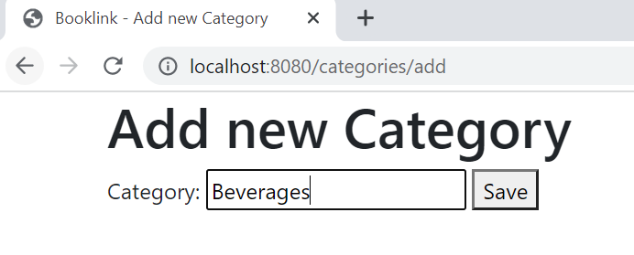
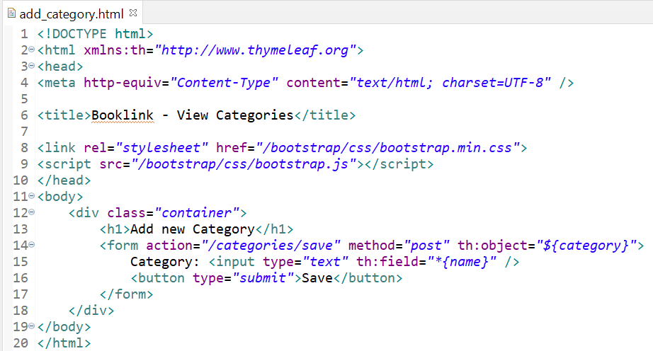
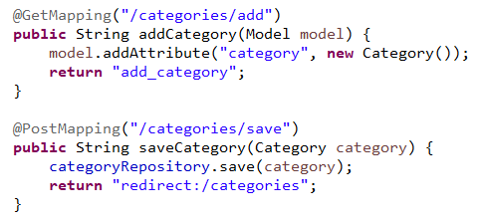
RECALL: Add a new Category using Forms
1. When the Save button is clicked, the data will be sent via the POST method to the location set in the action attribute of the form
2. The details will be passed as a category object to the method, saveCategory.
3. The category object containing the new information will be saved to the database using the save method from categoryRepository object.
Recall that the JpaRepository helps us with CRUD. No additional SQL is required to insert the data into the database.
4. After saving the new category, the page is then redirected to http://localhost:8080/categories/

Slide 15
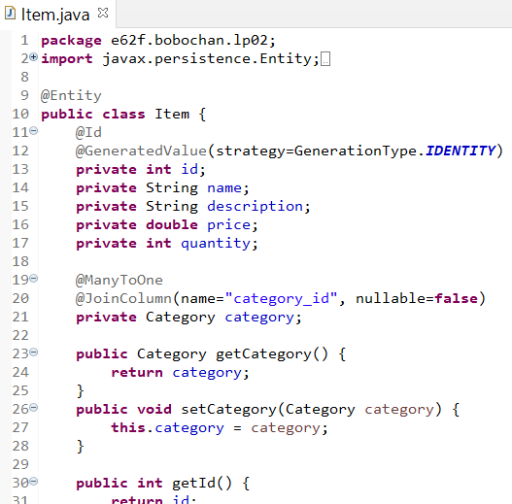
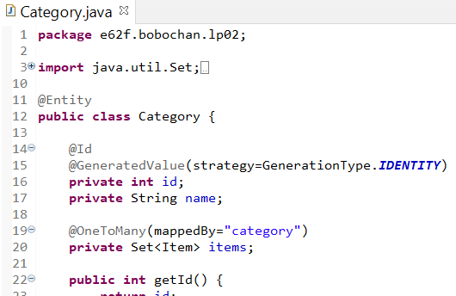
RECALL Joining Table – Category and Item
@JoinColumn defines the column to join the category and item tables.
The @OneToMany and @ManyToOne describes the relationship between the 2 entities.
A Set is a collection that does not contain any duplicate objects. In this case, items will not contain any duplicate Item objects. The @OneToMany annotation will be applied to items.
Category object added as a field here. The annotations @ManyToOne and @JoinColumn above will be applied to category.
mappedBy indicates link to category object in the Item class.

Slide 16
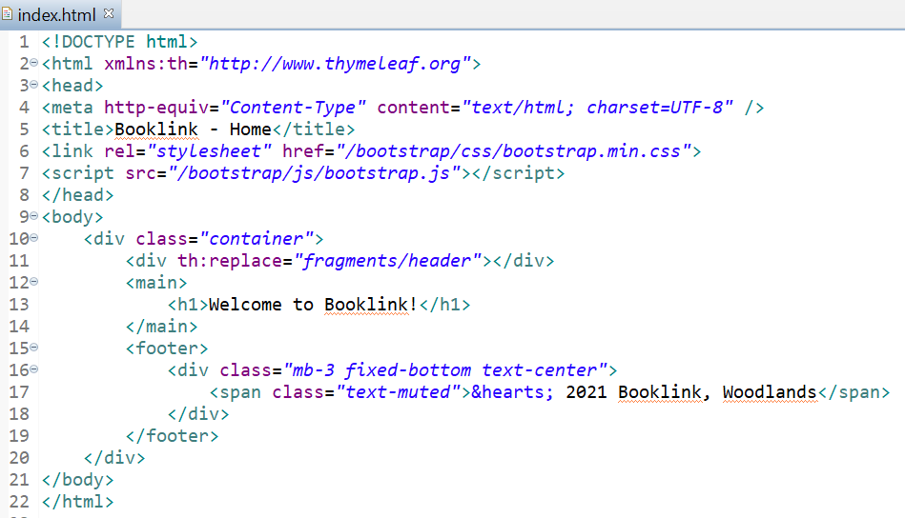
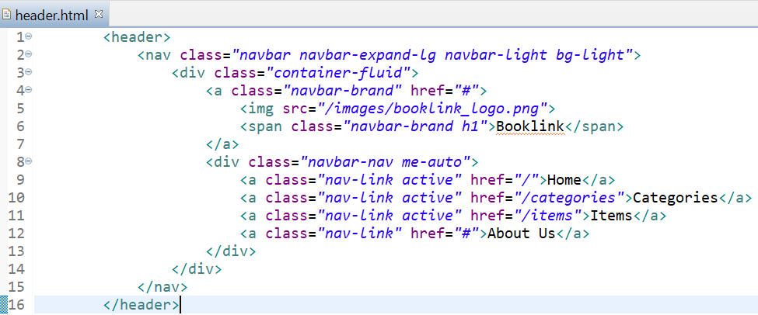
RECALL - Creating header fragment
From index.html, copy the header HTML code and paste it inside header.html.
In index.html, replace the header code with the reference to the fragment as shown.
Note that the mappings here are handled automatically by Thymeleaf.
We do not need to create the mappings ourselves in the controllers.

Slide 17
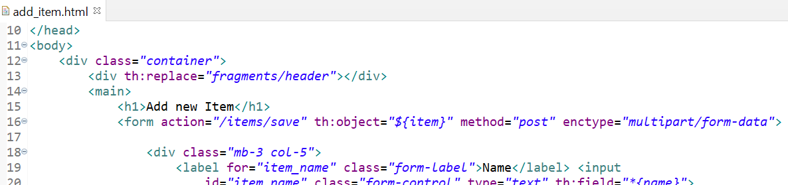
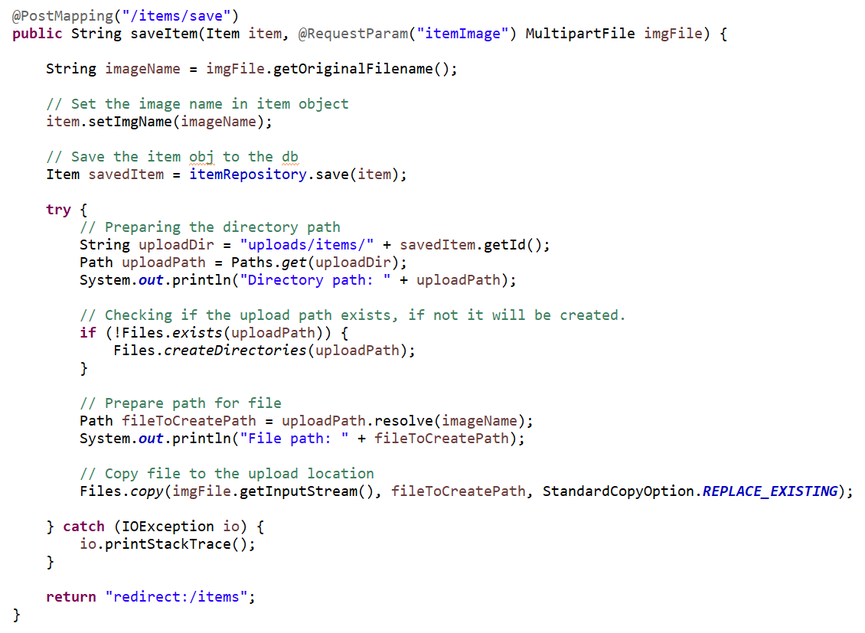
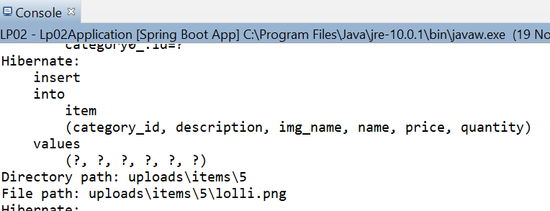
RECALL - Uploading Images
1. The enctype must be set to multipart/form-data if we have any input of type file.
2. Input name and requested param name must match
3. The id here is 5 as we already have 4 items added previously. The id may be different for you depending on how many items you added before this exercise.

Slide 18
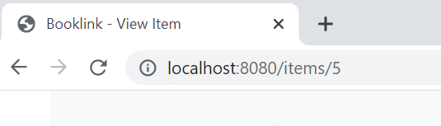
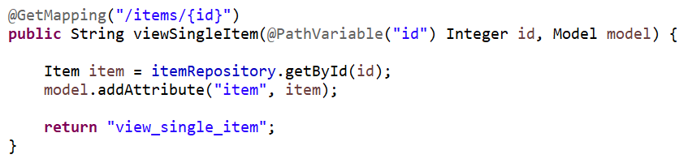
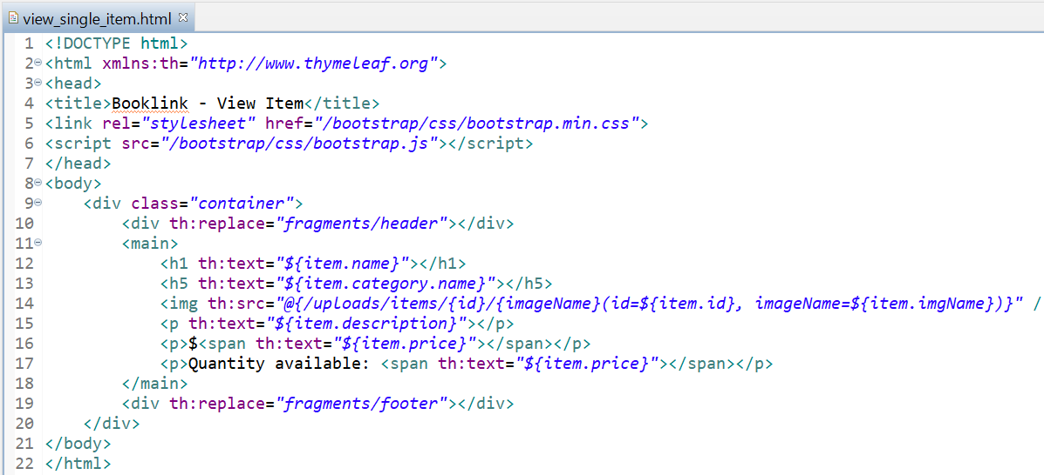
RECALL - View Single Item
1. The id is passed to the mapping which is then passed to the method as a PathVariable.
2. The getById method uses the id to retrieve the item object.
3. The @{..} is a thymeleaf link expression, used to evaluate expressions in a url.
Here we passed 2 parameters separated by , .

Slide 19
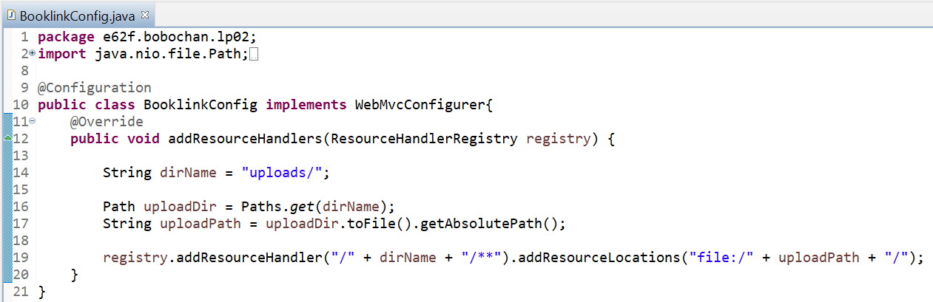
RECALL -Set Image Path using WebMVCConfigurer
1. @Configuration annotation is used here to indicate to Spring that this class should be instantiated and any dependencies should be injected
2. The WebMvcConfigurer is implemented here so that we can override the addResourceHandlers method to customize it for our purpose.
3. Stores registrations of resource handlers for serving static resources such as images, css files and others through Spring MVC. Resources can be served out of locations under web application root, from the classpath, and others.
Without adding a resource handler to the registry, we will not be able to access the resource, which resulted in our image not appearing on the website when we browsed to it earlier.
4. Adds a resource handler to serve static resources. The handler is invoked for requests that match one of the specified URL path patterns.
5. Adds a resource location from which to serve the files uploaded. The location must point to a valid directory

Slide 20
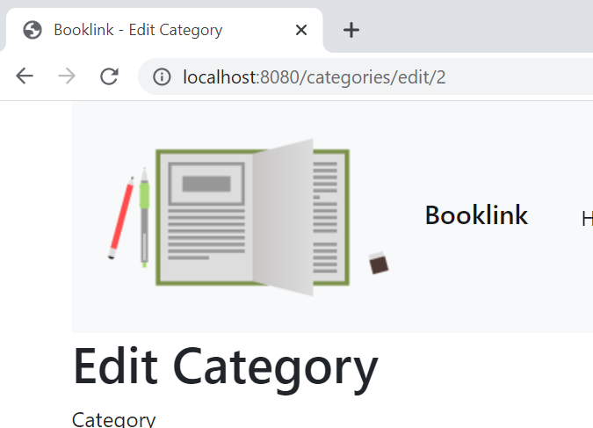
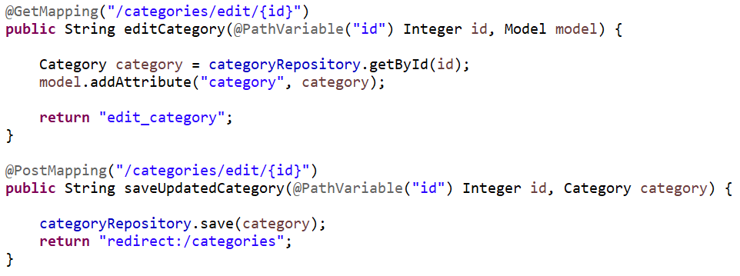
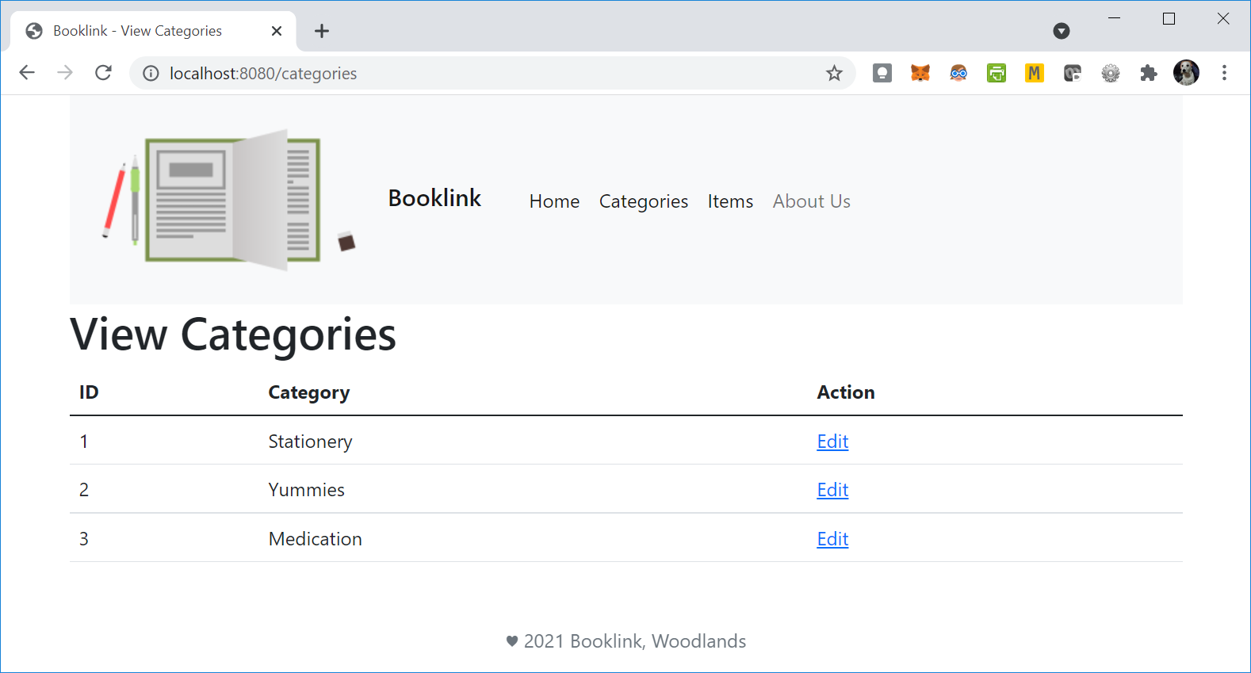
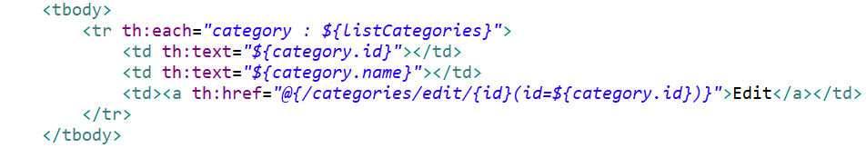
RECALL - Update Category
The @PathVariable is used to handle template variables in the request URI mapping, in this case, the item id. This will then be set as a method parameter, in this case also named id.
CategoryController.java
As we use the thymeleaf link expression to help us include parameters, we pre-fix the href with th: to indicate this to be processed by thymeleaf.
view_categories.html

Slide 21
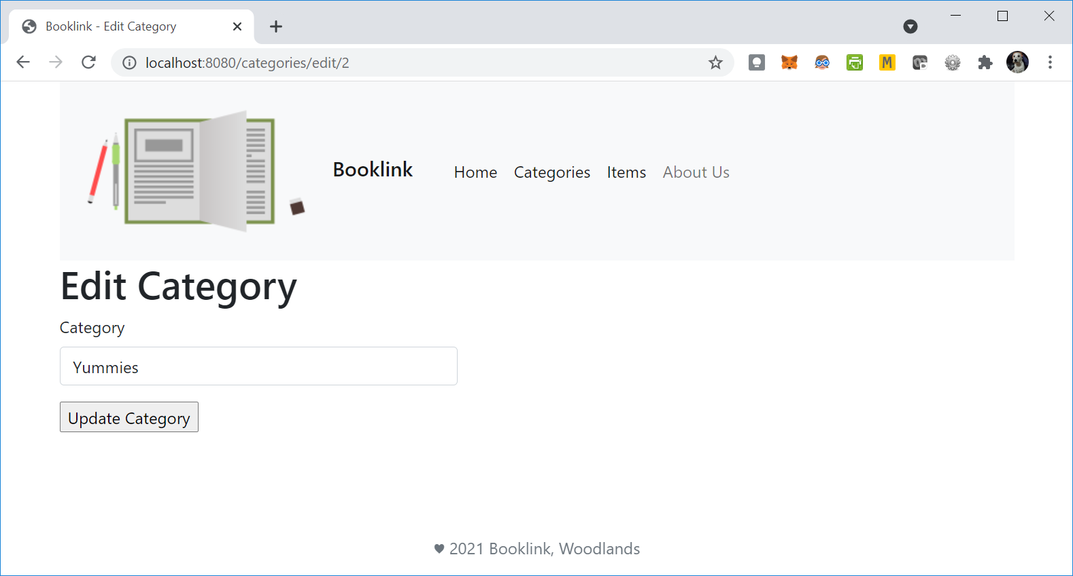
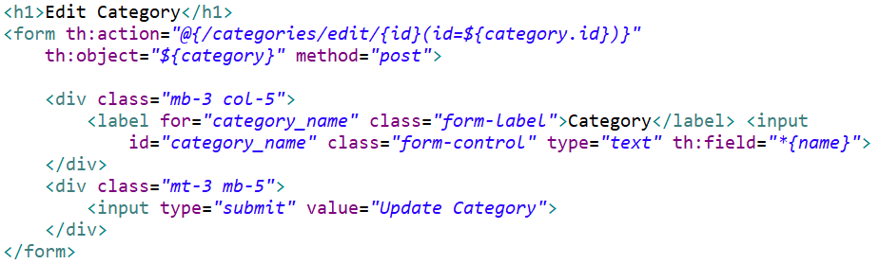
RECALL - Update Category
CategoryController.java
edit_category.html
When the Update Category button is clicked, the updated category will be sent to the path in the action attribute of the form, which will map to @PostMapping(“/categories/edit/{id}”)

Slide 22
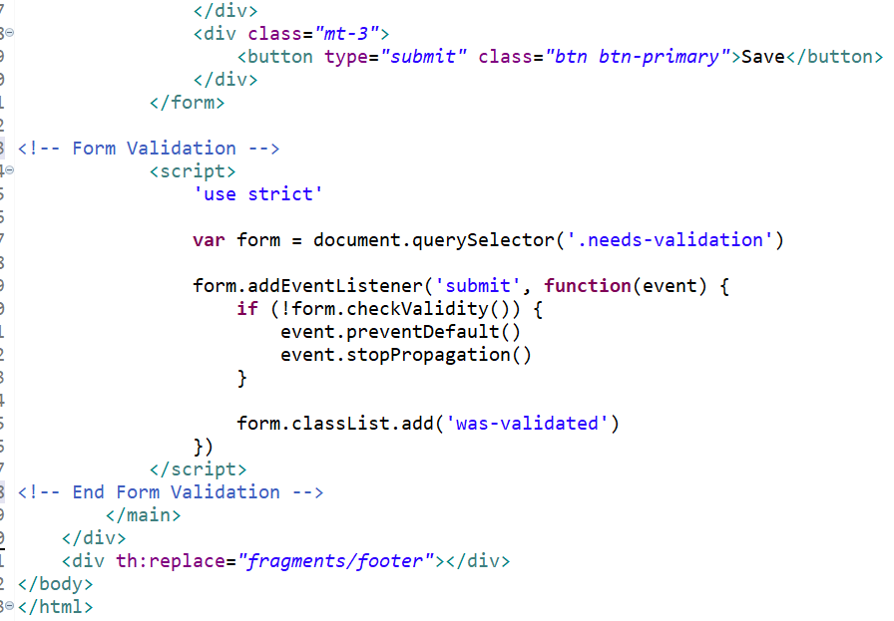
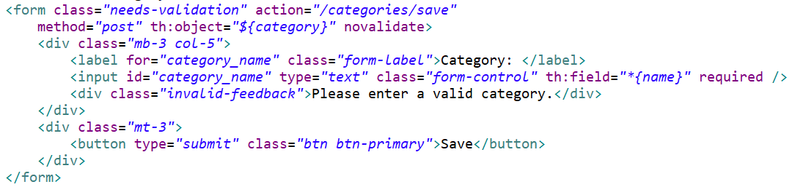
RECALL – FRONT END Validation
The querySelector is used to select the element with the stated class, in this case “needs-validation”
The checkValidity method checks whether the form has any constraints and whether it satisfies them.
If the required constraint fails, the form will not be allowed to continue to submit and the div with the “invalid-feedback” class will be displayed.
For custom Bootstrap form validation messages, you’ll need to add the novalidate boolean attribute to your <form>.
This disables the browser default feedback tooltips, but still provides access to the form validation APIs in JavaScript.

Slide 23
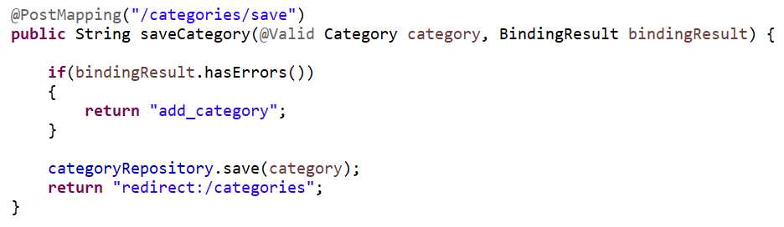
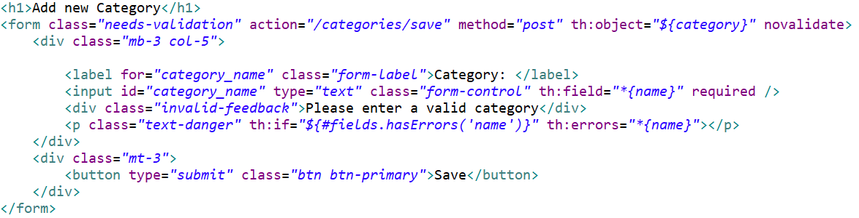
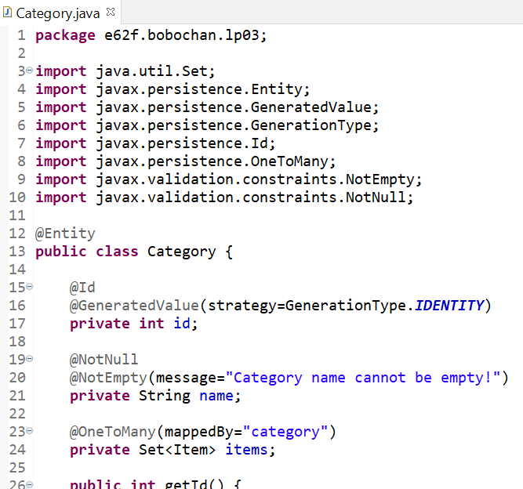
RECALL: BACK END Validation
Thymeleaf allows us to display errors as well.
th:if checks the #fields.hasErrors(...) function, which receives the field expression as a parameter (name), and returns a boolean telling whether any validation errors exist for that field.
th:errors is a specialized attribute which builds a list with all the errors for the specified selector, separated by <br />:

Slide 24
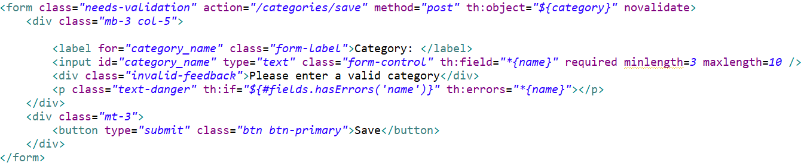
RECALL – Other Constraints Validation
2. However there is no change to the JavaScript code we had when writing the first constraint.
The checkValidity method checks whether the form has any constraints and whether it satisfies them. If any constraint fails, the form will not be allowed to continue to submit and the div with the “invalid-feedback” class will be displayed.
1. Observe that we have 2 constraints here:
No empty input allowed(required)
Input must be at least 3 characters and at most 10 characters long
Other constraints that can be applied:
https://developer.mozilla.org/en-US/docs/Web/Guide/HTML/Constraint_validation

Slide 25
Spring Security

Slide 26
Spring Security
Spring Security is a framework that provides authentication, authorization, and protection against common attacks.
Authentication is how we verify the identity of who is trying to access a particular resource.
A common way to authenticate users is by requiring the user to enter a username and password. Once authentication is performed we know the identity and can perform authorization.
Authorization is determining who is allowed to access a particular resource.

Slide 27
Dependency - Spring Security
Spring Boot provides security support as well with the Spring Security dependency.
Recall when creating a new project, we select the dependencies we think we will need for the new project.
However there may be times that we will need to include additional dependencies with an existing project.
We will include the Spring Security dependency via the pom.xml file.

Slide 28
Dependency - Spring Security
At the moment the booklink website is not secured in any way.
We will be modifying our project to include authentication.
To do this, we need to:
Include Spring Security dependency in pom.xml
Create a web security configuration file, WebSecurityConfig.java

Slide 29
Exercise 1 – Adding Spring Security dependency in POM
We will include the Spring Security dependency for LP03 project in the pom.xml file.
Copy the dependency details here and paste into pom.xml:
<dependency>
<groupId>org.springframework.boot</groupId>
<artifactId>spring-boot-starter-security</artifactId>
</dependency>

Slide 30
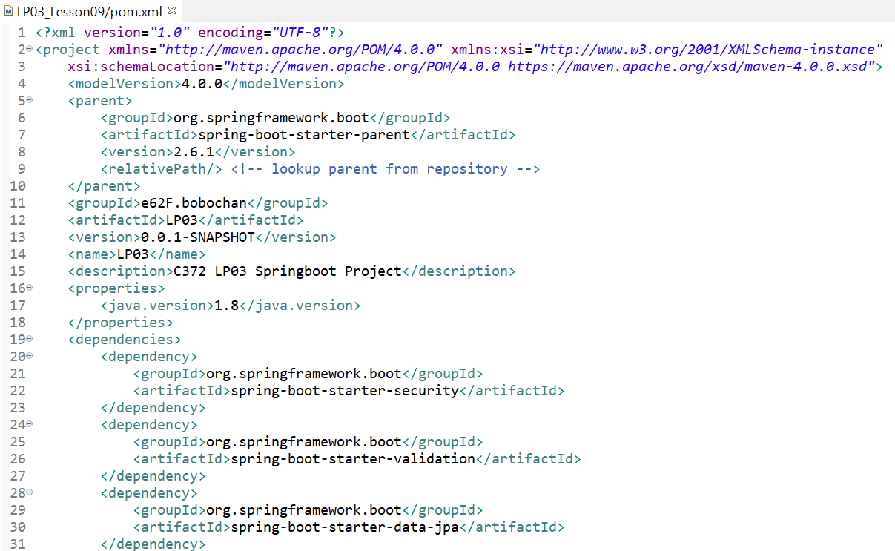
Exercise 1 – Adding Spring Security dependency in POM
Your pom.xml should look like below.
Save pom.xml and the Springboot project will automatically* load the required libraries.
*Ensure that you are connected to the internet

Slide 31
Authentication with Spring Default User

Slide 32
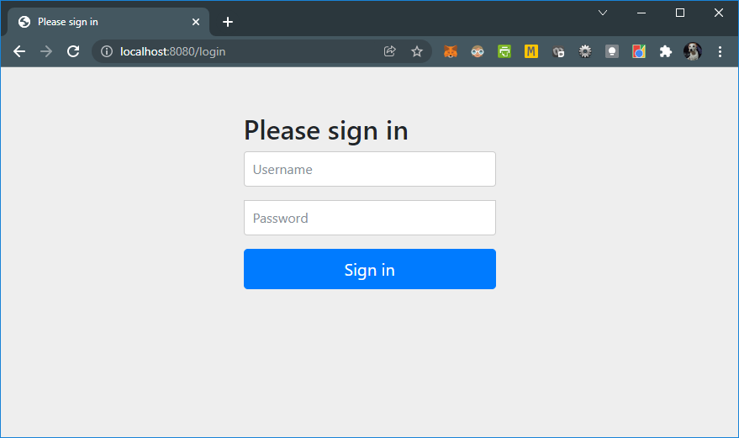
Exercise 2 – Sign in page
Run the springboot application
Go to http://localhost:8080/
You will see the following page:
This page is automatically generated when you add the Spring security dependency

Slide 33

Exercise 2 – Sign in page
Try accessing other pages that you have previously accessed
E.g.
http://localhost:8080/categories
http://localhost:8080/items
Write down your observations.

Slide 34
Exercise 2 – Sign in page
Try accessing other pages that you have previously accessed
E.g.
http://localhost:8080/categories
http://localhost:8080/items
Write down your observations:
You are not able to view the web pages as access is blocked.
You are also asked to login with a username and password.

Slide 35
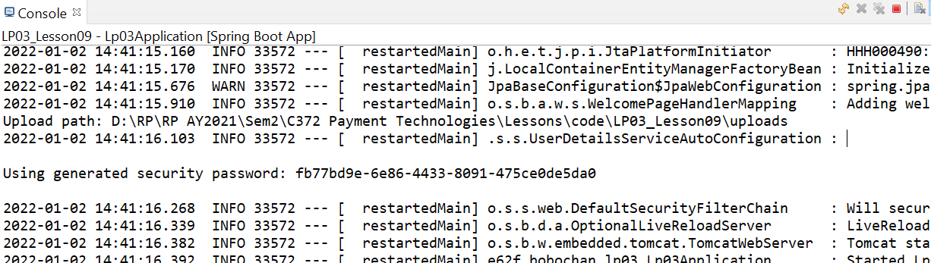
Exercise 3 – Spring Security Default user
In the console when you ran your springboot application, you will see a password being generated.
Note:
This password changes everytime you run the springboot application.
The default username to login is “user”

Slide 36
Exercise 3 – Spring Security Default user
Login to the page with the default username and password generated.
Try accessing the pages that you have previously accessed again
E.g.
http://localhost:8080/categories
http://localhost:8080/items

Slide 37
Exercise 3 – Spring Security Default user
Now go to this url: http://localhost:8080/logout
Write down your observations.

Slide 38
Exercise 3 – Spring Security Default user
Now go to this url: http://localhost:8080/logout
Write down your observations
A prompt is shown to ask if we wish to logout.
Once clicked, we are signed out and access to the website is blocked again

Slide 39
Exercise 3 – Spring Security Default user
At this stage, the whole website is secure as we need to login to access all pages. However, what are the issues with this setup at the moment?
Notes:
Students may be able to think of more issues

Slide 40
Exercise 3 – Spring Security Default user
At this stage, the whole website is secure as we need to login to access all pages. However, what are the issues with this setup at the moment?
Not all webpages need to be restricted. For e.g the homepage is usually available for viewing to all users.
We are not able to differentiate the user access for different types of users. For e.g. normal users, administrators
We only have one user
Notes:
Students may be able to think of more issues

Slide 41
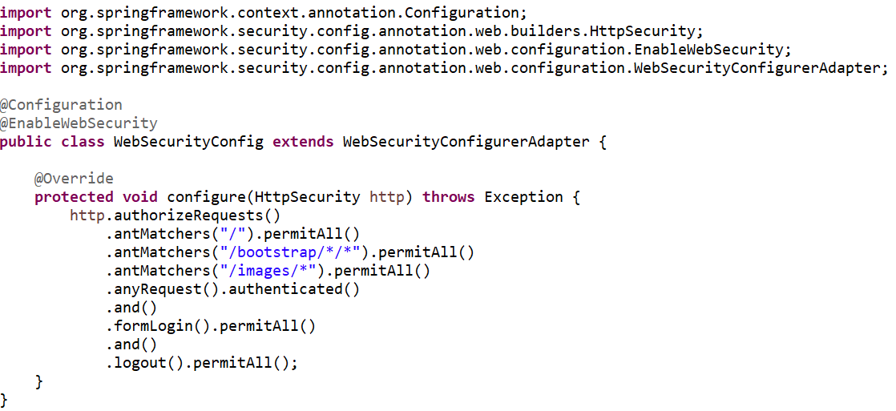
Exercise 3 – Spring Security Default user
Create a new class named WebSecurityConfig.java
Add the following code to WebSecurityConfig.java
Remember you can use Ctrl-Shift-o to import all required libraries
Note:
The user password will also change if there are updates to this file. Check the console for the updated password.
The default username to login is “user”

Slide 42
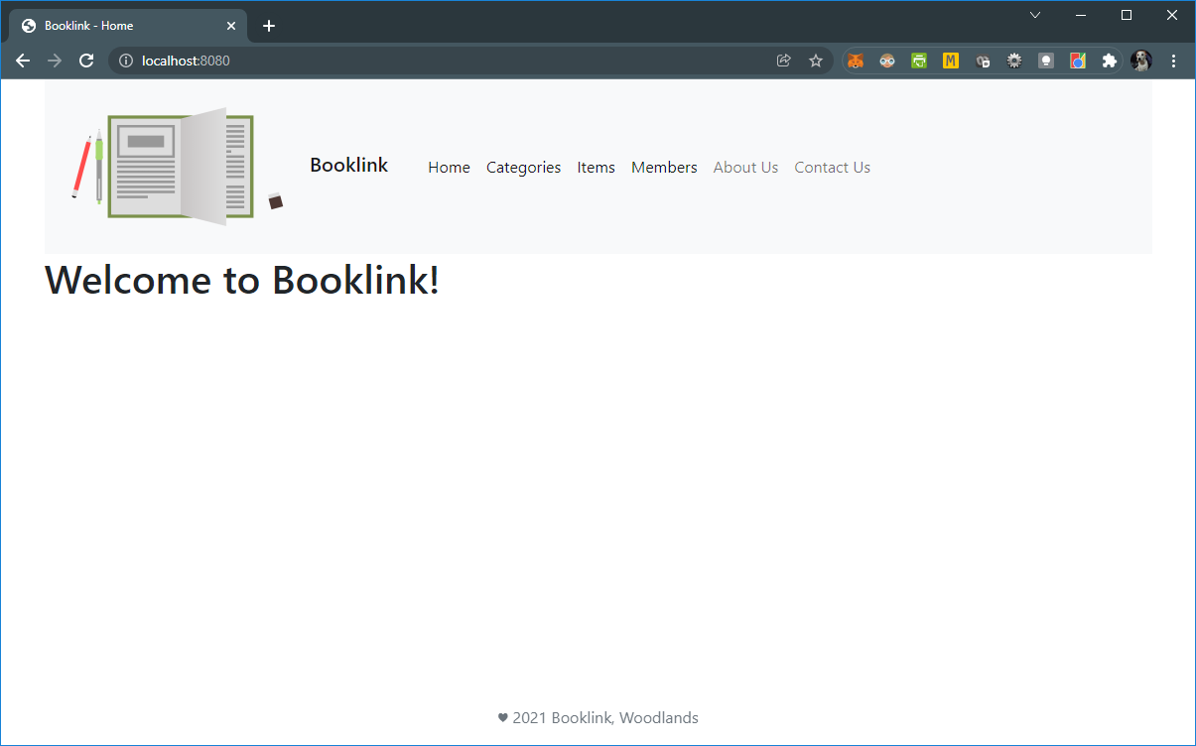
Exercise 3 – Spring Security Default user
Go to the url in your web browser: http://localhost:8080/
You should now be able to access the homepage, but not the other web pages unless you login to the website.

Slide 43
How it works
1. @EnableWebSecurity enable Spring Security’s web security support and provide the Spring MVC integration.
2. The WebSecurityConfigurerAdapter allows us to configure security settings in Spring. By extending it, we can override some methods to customize the configurations.
3. The configure(HttpSecurity) method defines which URL paths should be secured and which should not.
4. Specifically, the “/”, “/bootstrap/*/*”, and “/images/*” paths are configured to not require any authentication.
All other paths must be authenticated.
The antMatcher method matches url paths based on rules. E.g. * matches zero or more characters.
5. Spring security provides default login and logout functions. We can also customize these if we want to.

Slide 44

BREAK

Slide 45
Authentication with Custom users

Slide 46
Custom users
In most cases, we would require more than just a default user created by Spring.
We may want to include other information as well, such as email, date-of-birth, contact, etc.
Spring security provides some standard interfaces that we can make use of to implement our custom users.

Slide 47
User related classes provided by Spring Security
Related package:
org.springframework.security.core.userdetails
User
Models core user information retrieved by a UserDetailsService.
UserDetails
Provides core user information.
UserDetailsService
Provides the loadUserByUsername method to look up a user
This class is used to connect to JPA services
https://docs.spring.io/spring-security/site/docs/current/api/org/springframework/security/core/userdetails/User.html
https://docs.spring.io/spring-security/site/docs/current/api/org/springframework/security/core/userdetails/UserDetails.html
https://docs.spring.io/spring-security/site/docs/current/api/org/springframework/security/core/userdetails/UserDetailsService.html
Notes:
https://docs.spring.io/spring-security/site/docs/current/api/org/springframework/security/core/userdetails/UserDetails.html
https://docs.spring.io/spring-security/site/docs/current/api/org/springframework/security/core/userdetails/User.html
https://docs.spring.io/spring-security/site/docs/current/api/org/springframework/security/core/userdetails/UserDetailsService.html

Slide 48
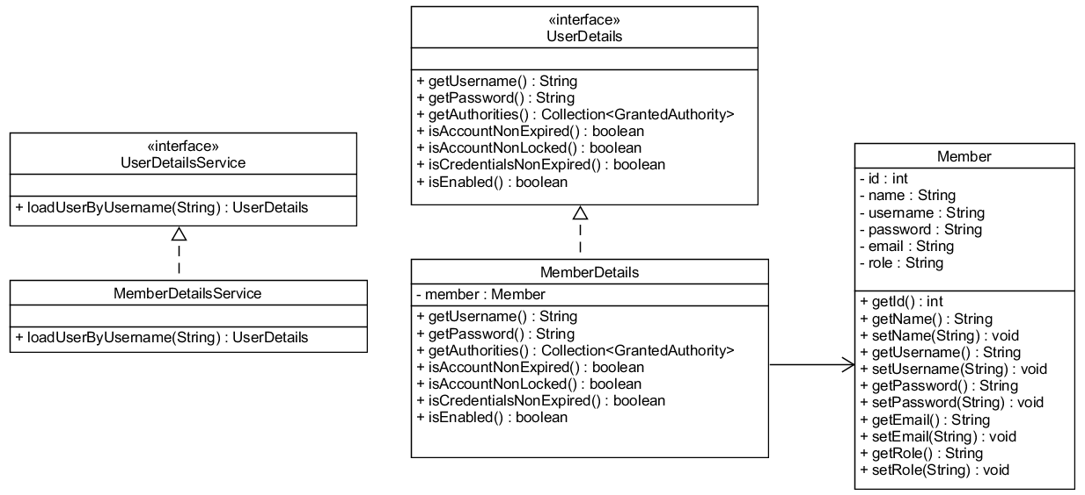
Custom User related classes
We can make use of the user related classes provided by Spring Security and build our custom user classes on top of what is already provided.
Notes:
Ask students what do the arrows mean and how to read the diagram. They have learnt some UML previously in C208, C209
MemberDetails implements UserDetails
MemberDetailsService implements UserDetailsService
MemberDetails depend on Member

Slide 49
Custom User related classes
Member
Entity class
Additional non-security related user information (such as email addresses, telephone numbers etc)
MemberDetails
Includes the Member class and implements UserDetails interface provided by Spring Security
Provides core user information.
MemberDetailsService
Provides the loadUserByUsername method to look up a user
Implement the UserDetailsService interface to connect to JPA services

Slide 50
Exercise 4 – Custom User related classes
In the previous lesson*, you were asked to create a simple Member class.
We will be:
Modifying the Member entity class
Modify the MemberRepository class
Create the MemberDetails class that implements UserDetails interface
Create the MemberDetailsService class that implements UserDetailsService interface
Update the WebSecurityConfig class to set authentication and authorization
*Recall that you should have also created the MemberRepository and MemberController classes.

Slide 51
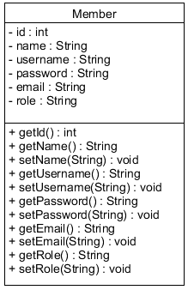
Exercise 4 – Custom User related classes
Stop the Springboot application if it is still running.
Drop the member table from MySQL workbench
Modify the Member class according to the class diagram shown:

Slide 52
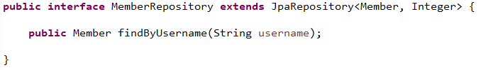
Exercise 4 – Custom User related classes
Modify the MemberRepository class
Recall that Spring JPA provides us some standard useful methods such as findById, findAll, etc. We can also include our own methods in our repository interfaces with the convention “findBy…”.
In the case here, username is a field in the Member class, hence we can create a method here called findByUsername.
Spring JPA will recognize the convention we used and match this to the Member entity and table, search though the records in the database to find a Member with the username we specified. No additional code is required.

Slide 53
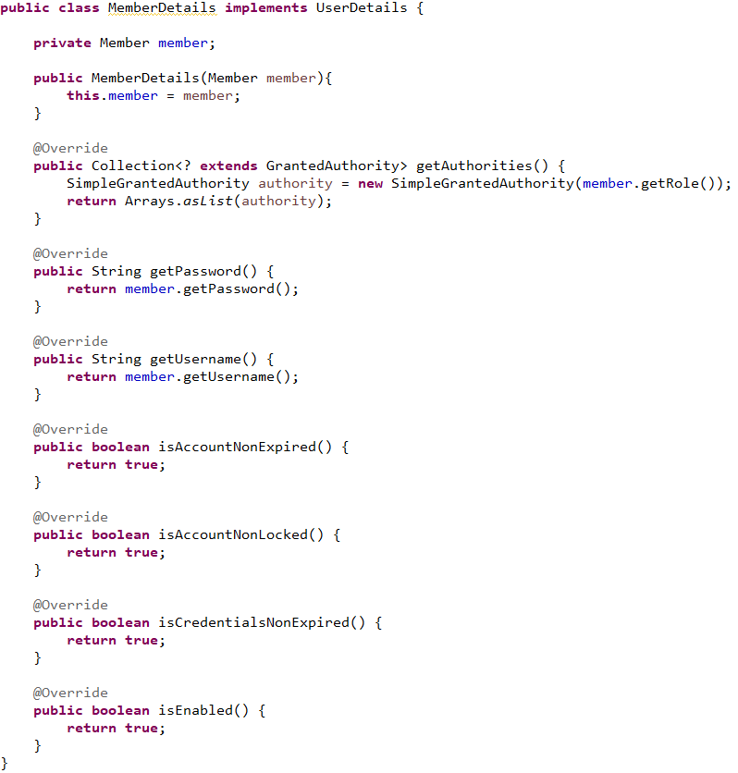
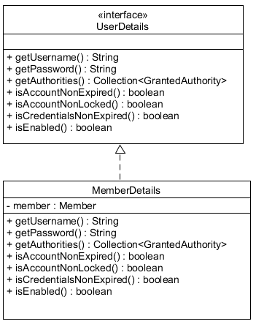
Exercise 4 – Custom User related classes
Create the MemberDetails class that implements UserDetails interface
Notes:
Note that UserDetails should not be created as it is already provided by Spring security

Slide 54
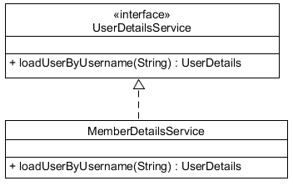
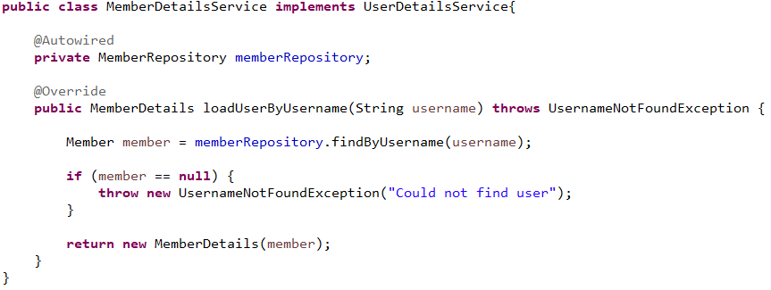
Exercise 4 – Custom User related classes
Create the MemberDetailsService that implements the UserDetailsService interface
Notes:
Note that UserDetailsService should not be created as it is already provided by Spring security

Slide 55
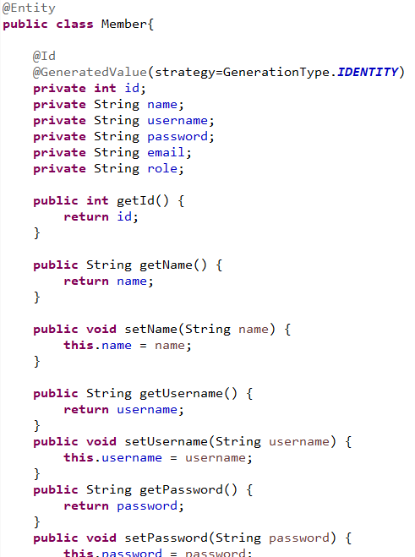
How it works
MemberDetails implements UserDetails and includes Member.
This allows us to include custom user information, and leverage on Spring Security
These methods are set to true by default now as we are not using them in this project.
MemberDetailsService implements UserDetailsService which has only 1 method, which is loadUserByUsername. This class allows us to connect to JPA services

Slide 56

LUNCH

Slide 57
Authorisation

Slide 58
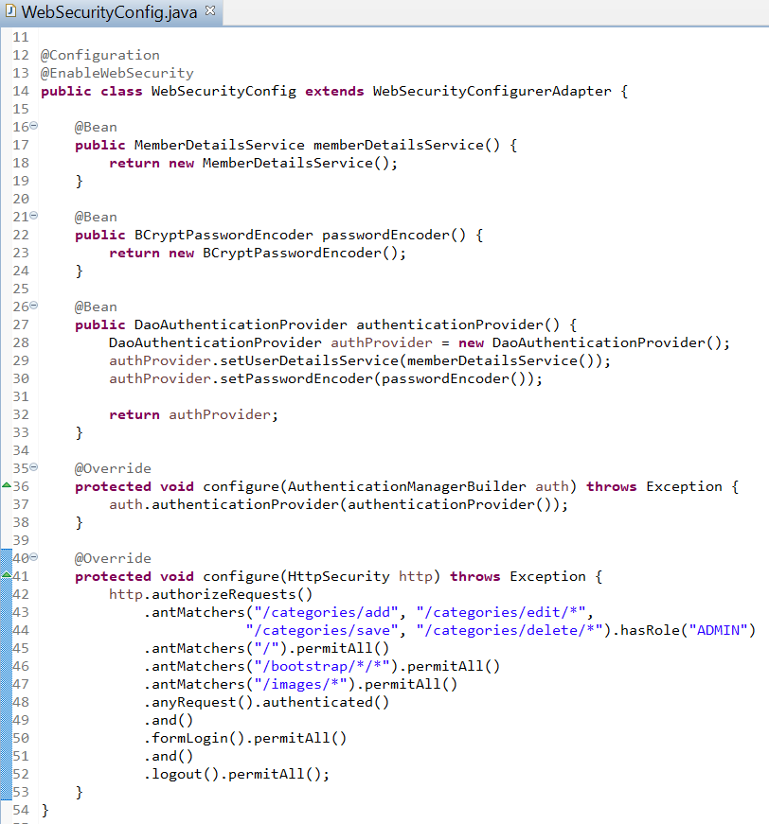
Exercise 5 – Access Control
Update the WebSecurityConfig class to set authentication and authorization

Slide 59
Exercise 5 – Access Control
Based on the code below from WebSecurityConfig, list down the urls that a user with role USER or ADMIN can access.
Role | URL
USER
ADMIN | All

Slide 60
Exercise 5 – Access Control
Based on the code below from WebSecurityConfig, list down the urls that a user with role USER or ADMIN can access.
Role | URL
USER | http://localhost:8080/ http://localhost:8080/categories http://localhost:8080/items http://localhost:8080/items/add http://localhost:8080/items/edit/<id> http://localhost:8080/items/save http://localhost:8080/items/delete/<id>
ADMIN | All

Slide 61
Exercise 5 – Access Control
Run LP03 springboot program
The member table should be regenerated in MySQL Workbench
member.sql is provided to you, copy the statements and execute them in workbench
There should be 2 members in the member table (Password is “password”)

Slide 62
Cross Site Request Forgery (CSRF)
Cross-site request forgery is a type of malicious exploit of a website where unauthorized commands are submitted from a user that the web application trusts
There are many ways in which a malicious website can transmit such commands; specially-crafted image tags, hidden forms, and JavaScript XMLHttpRequests, for example, can all work without the user's interaction or even knowledge.
In a CSRF attack, an innocent end user is tricked by an attacker into submitting a web request that they did not intend. This may cause actions to be performed on the website that can include inadvertent client or server data leakage, change of session state, or manipulation of an end user's account.
Notes:
https://en.wikipedia.org/wiki/Cross-site_request_forgery

Slide 63

Cross Site Request Forgery (CSRF)
Notes:
https://www.youtube.com/watch?v=5joX1skQtVE

Slide 64
CSRF Prevention
To prevent CSRF, a CSRF token needs to be used. This token is a secure random token that needs to be unique per user session.
Spring Security’s CSRF protection is enabled by default and the CSRF token gets injected automatically. The CSRF protection can be configured further if required.
In Thymeleaf, the CSRF token is also automatically injected if we use the attribute th:action instead of just action in a form.

Slide 65

CSRF Prevention
You can use the web browser inspector to view the CSRF token generated

Slide 66

Exercise 6 - Cross Site Request Forgery (CSRF)
Check that all the webforms are using the th:action attribute:
add_item.html
add_category.html
add_member.html
edit_item.html
edit _category.html
edit _member.html
If the th:action attribute is not used, modify the code to use th:action.
An example is shown below:
Notes:
Custom login page need to add in?
https://docs.spring.io/spring-security/site/docs/5.0.x/reference/html/csrf.html

Slide 67
Exercise 6 - Cross Site Request Forgery (CSRF)
In the inspector, edit the CSRF token generated and replace it with “123”.
Attempt to login as billy.
Refresh the page and attempt to login as billy again.
Write down your observations.
Notes:
Lecturer to demo to students

Slide 68
Exercise 6 - Cross Site Request Forgery (CSRF)
In the inspector, edit the CSRF token generated and replace it with “123”.
Attempt to login as billy.
Refresh the page and attempt to login as billy again.
Write down your observations.
After editing the CSRF token, we are not able to login despite using the correct username and password. Once the page is refreshed with a valid csrf token, we are able to login again.
Notes:
Lecturer to demo to students

Slide 69
Exercise 7 – Member roles access
Test your website by logging in as billy(USER) and admin(ADMIN) to check that the web pages are restricted as expected.
Role | URL
USER | http://localhost:8080/ http://localhost:8080/categories http://localhost:8080/items http://localhost:8080/items/add http://localhost:8080/items/edit/<id> http://localhost:8080/items/save http://localhost:8080/items/delete/<id>
ADMIN | All

Slide 70
Exercise 7 – Member roles access
Modify WebSecurityConfig so that only users with ADMIN role is able to access the following URLs:
http://localhost:8080/items/add
http://localhost:8080/items/edit/<id>
http://localhost:8080/items/save
http://localhost:8080/items/delete/<id>

Slide 71
Handling Restricted Access

Slide 72

Error 403
When a user accesses a restricted page with insufficient access rights, the 403 error will occur as shown.

Slide 73

Error 403
The 403 error happens when the user is not authorized to access the page.
As developers, we know that this behavior is correct, however we should provide feedback that is understandable to the non-IT person.

Slide 74
Exercise 8 – Error codes
The 403 error code is one type of error.
What do the following error codes mean?
Error Code | Description
403 | Forbidden. User may not have sufficient permissions to access this page.
200
404
500

Slide 75
Exercise 8 – Error codes
The 403 error code is one type of error.
What do the following error codes mean?
Error Code | Description
403 | Forbidden. User may not have sufficient permissions to access this page.
200 | OK. Standard response for successful HTTP request.
404 | Not Found. Page or resource is missing or could not be found
500 | Internal Server error. Generic message given when there was an unexpected condition and the system is unable to provide a more specific message.

Slide 76

Exercise 8 – Error codes
In the templates folder, make a copy of index.html and rename the file to 403.html
Replace the “Welcome to Booklink!” text to the text shown:

Slide 77

Exercise 8 – Error codes
Modify the code in WebSecurityConfig class as shown:

Slide 78

Exercise 8 – Error codes
Modify the HomeController class as shown:

Slide 79
Exercise 8 – Error codes
Try logging in as “billy” again and access the pages that are restricted.
Paste your code into the worksheet.

Slide 80
How it works
1. When user attempts to access a page that is unauthorized, the server will return a 403 error. We have configured it here with the /403 path
2. The mapping then returns the 403.html view.

Slide 81
Adding New Members

Slide 82
Adding New Members
In the previous lesson, you should have created a simple add_member.html view.
However, remember we have updated the Member class with more information.
We will now update the add_member.html to reflect the new information.

Slide 83


Adding New Members
We will need to modify:
add_member.html
view_members.html
MemberController.java

Slide 84
Exercise 9 - Adding New Members
Modify add_member.html
For the password and email field, you can use the input types password and email respectively.
https://www.w3schools.com/html/html_form_input_types.asp
Notes:
Students should be able to make use of what they have learnt previously. Remind them to name the inputs appropriately.

Slide 85

Exercise 9 - Adding New Members
Modify MemberController.java

Slide 86

Exercise 9 - Adding New Members
Modify view_members.html

Slide 87
Exercise 9 - Adding New Members
Try adding a new user
Logout of the existing account and try logging in with the new account that you just created.
What is the password stored in your database?

Slide 88
Exercise 9 - Adding New Members
Try adding a new user
Logout of the existing account and try logging in with the new account that you just created.
What is the password stored in your database?
$2a$10$J/hGdsCIGzhididFsR.8Juhc/Xo54qrCf8A.hamT1veqiAfGWQzcG
Your password will be different depending on what you set as the password.

Slide 89
How it works
1. Spring Security’s PasswordEncoder interface is used to perform a one way transformation of a password to allow the password to be stored securely.
BCryptPasswordEncoder is an implementation of PasswordEncoder that uses the BCrypt strong hashing function.
The member object is then updated with the encoded password. The role is also set here, to a default “ROLE_USER”
2. RedirectAttributes is a specialization of the Model interface that controllers can use to select attributes for a redirect scenario.
Here we have used it to add an attribute named success. We also use bootstrap classes to style it.
Notes:
https://docs.spring.io/spring-security/site/docs/current/api/org/springframework/security/crypto/bcrypt/BCryptPasswordEncoder.html
https://docs.spring.io/spring-framework/docs/current/javadoc-api/org/springframework/web/servlet/mvc/support/RedirectAttributes.html

Slide 90
Custom Login/Logout

Slide 91
Custom Login/Logout
Currently, the login page is the default login page provided by Spring Security.

Slide 92

Custom Login page
We can customize the page so that we can include the Booklink headers.

Slide 93


Custom Login/Logout
However, we also need to update the headers so that we can allow visitors can login, and logged in members can logout.

Slide 94
Custom Login/Logout
We will need to do the following:
Create login.html
Create LoginController.java
Update WebSecurityConfig.java
Update header.html
Update index.html

Slide 95

Exercise 10 - Custom Login/Logout
Stop the springboot application before making changes.
Using index.html as our base, make a copy of index.html and rename the file to login.html
In the main element, remove the heading with the welcome message and replace it with the form shown:

Slide 96

Exercise 10 - Custom Login/Logout
Create LoginController.java with the mapping and view as shown

Slide 97

Exercise 10 - Custom Login/Logout
In WebSecurityConfig.java, modify the login and logout functions as shown

Slide 98

Exercise 10 - Custom Login/Logout
Modify header.html as shown

Slide 99

Exercise 10 - Custom Login/Logout
Thymeleaf provides spring security integration as well.
Paste the following dependency into pom.xml
<dependency>
<groupId>org.thymeleaf.extras</groupId>
<artifactId>thymeleaf-extras-springsecurity5</artifactId>
</dependency>

Slide 100

Exercise 10 - Custom Login/Logout
Modify index.html to include the namespace as shown:

Slide 101
Exercise 10 - Custom Login/Logout
Run the springboot application
Try logging in with billy and admin to test the application.

Slide 102
How it works
We provided a form for logout because we have CSRF protection enabled in Spring. Hence logging out must be done using the POST method.
Thymeleaf provides spring security integration, it allows us to display content specific to a user’s roles and also display some information about the current logged in user.
This user is referred to as the Principal user in spring security.
https://www.thymeleaf.org/doc/articles/springsecurity.html
Notes:
https://www.thymeleaf.org/doc/articles/springsecurity.html

Slide 103
PS: Managing Member Access

Slide 104
PS: Managing Member Access
Update your code so that access to the functions are restricted:
Members with ROLE_ADMIN access should be able to:
View/add/edit/delete categories, items and members
Log out
Members with ROLE_USER access should only be able to:
View categories and items
Log out

Slide 105
PS: Managing Member Access
Describe some ways to improve the Booklink website. This could include making the website more user friendly, more efficient, hiding unnecessary information, etc.
Implement the improvements in your code.

Slide 106
Summary
In this lesson, you learnt how to:
Implement access control through authentication and authorization
Handle restricted access
Register new users
Customize login pages

Slide 107
Thank you Q&A

